Slide 1
Adult Promise Project: Implementing and Financing State Efforts to Improve Adult Learner Attainment
Andy Carlson
January 28, 2018
With generous support from Lumina Foundation

Slide 2
Presentation overview
About SHEEO
Project overview
Making the case
The evolution of a policy idea
Design Template overview
State pilot programs

Slide 3
About SHEEO
The national association of the chief executives of statewide governing, policy, and coordinating boards of postsecondary education
Founded in 1954
Advocate for state policy leadership, act as a liaison between states and the federal government, and provide information and analysis on educational and public policy issues
SHEEO currently has 61 members in all 50 states, two territories, and the District of Columbia
Recognize that state context matters
Notes:
AC
Read slide.
Board of Governors for Florida University System.
Our members include governing boards for one system of institutions, like the Cal State University System or the George Board of Regents, to coordinating boards like the Washington Student Achievement Council and the Indiana Commission for Higher Education.
Our members, the chief executives, are in political positions and as I mentioned earlier, working in these spaces can feel distanced from you all on the ground directly serving students. That said, regardless of political persuasion, the majority of our members are committed to a state attainment goal and closing equity gaps .

Slide 4
SHEEO Vision Statement
…vision of student success where all students, regardless of socioeconomic status or demographic category, have equal opportunity to enroll and likelihood to succeed in postsecondary education. Students will earn a high quality degree or credential that prepares them for success in society, the workforce, and in their civic roles. Our mission, efforts, and activities will assist our members in closing equity gaps and making the necessary gains to reach their state attainment goals…
Notes:
With that in mind, our vision statement organizes our work around serving our members and helping them reach their attainment goals.
Read slide

Slide 5
About the project
Phase I – January through October 2016
Produced design template document for states looking to implement Adult Promise programs
Site visits to five states
Produced a customized program implementation plan for each state
Phase II - 2017 through 2019
Implementing programs in five states
Indiana
Maine
Minnesota
Oklahoma
Washington
Annual summary white papers (first in March 2018)
Convenings, webinars, and site visits as needed
www.sheeo.org/adultpromise
Notes:
Phase I – is it feasible to do this type of aid program for adult learners?
Are states and our members interested in trying this out as a pilot?
What would it cost?
What supports and services are critical to increase the likelihood that adult students succeed?
Read slide
Phase II – Now let’s do the work in five states. Enrollments beginning in fall 2018.
Pulling in outside experts:
CCA
NASPAA
CLASP
MDRC
VOX
Other states

Slide 6
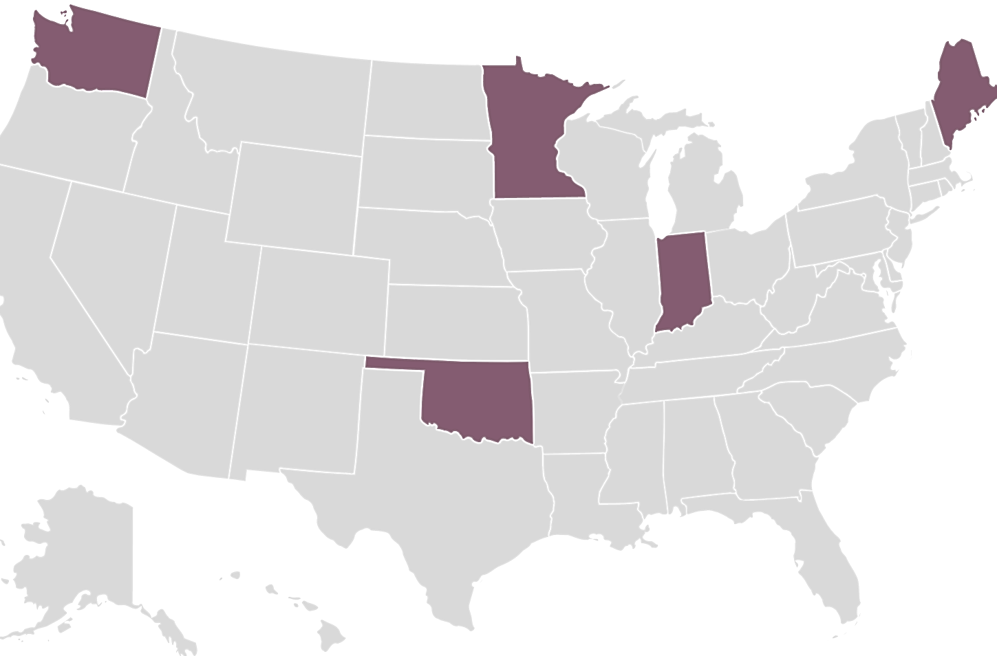
The pilot states
WA
MN
ME
IN
OK
Notes:
Reasonable geographic coverage in the pilot states.
Another interesting facet from SHEEO’s perspective, is that these states provide a good variety of governance structure. Coordinating boards in Indiana and Washington. Governing boards with more authority in Maine and Oklahoma. And in MN we are working with a coordinating board and a governing board that oversees their community colleges.

Slide 7
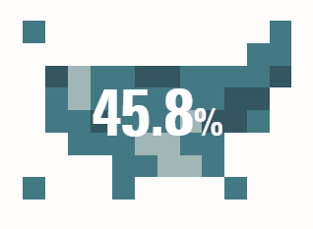
The need
Our workforce needs more educated workers than we are on track to produce, largely due to:
Stagnation in high-school graduates
Changing demographics
Retirement of baby-boomers
Modernization of jobs
Lumina’s big goal is 60 percent with a credential of value by 2025
Notes:
Currently at 45.8 percent attainment nationally. - http://strongernation.luminafoundation.org/report/2017/#nation
The nation faces an urgent and growing need for talent. To meet that need, many more people must earn college degrees, workforce certificates, industry certifications and other high-quality credentials. That’s why Lumina Foundation focuses on Goal 2025. We want to ensure that, by 2025, a system exists that is easy to navigate and has helped 60 percent of Americans earn credentials that prepare them for informed citizenship and for success in a global economy.

Slide 8
The need – state specific
40 states have now set attainment goals
Over half of all states cannot meet their attainment goals without adult students
State | Current Attainment | Attainment Goal | “Some College”
Indiana | 41% | 60% | 750,000
Maine | 43% | 60% | 200,000
Minnesota | 54% | 70% | 143,000
Oklahoma | 40% | 70% | 600,000
Washington | 52% | 70% | 400,000
Notes:
Over half of all states won’t meet their attainment goals without adult students
- Pingel, Parker, & Sisneros, 2016; Zanville et al., 2008). Free community college: an approach to increase adult student success in postsecondary education.

Slide 9
The evolution of a policy idea
Attainment Goals
Promise Programs
Research on today’s student
Promise Programs for adult learners
Notes:
I want to spend a little time on how this concept has evolved. Earlier I described how the original grant was meant to assess the feasibility of adult promise programs. In 2016, this was really an out there idea. Traditional promise programs were being implemented in Tennessee and Oregon, and many states were considering doing so through legislation. ECS found about 30 states had some sort of legislative proposal to create a promise program for traditional students straight from high school.

Slide 10
The quintessential promise program
Tennessee Promise
Geared towards traditional-aged students who enroll while in high school and meet eligibility requirements
Guaranteed free tuition and mandatory fees through last dollar scholarship after Pell and other state aid.
Scholarship must be used at 13 CCs or 27 technical colleges
Notes:
Read slide.
Idea came from two disparate entities. One, there was a local promise program in Knoxville that was very successful. Two, staff at the Tennessee Higher Education Commission analyzed their state’s student level data and realized the vast majority of their community college students were getting a pell grant that more than covered their tuition and fees charges.

Slide 11
More than a last dollar scholarship
It’s the message that matters
Most students already receive sufficient Pell awards to cover tuition
Mentoring component
Volunteer mentors help student navigate the admissions process
Notes:
Program increased enrollments at community colleges. Retention rates have remained basically the same. So, completions should increase over time.
Mixed views on whether or not the program is increasing equity gaps.
If you talk to Mike Krause, the executive director at the Tennessee Higher Education Commission, he’ll say it’s the message that matters. Most students aren’t getting more aid. But, something change, it’s really the message of free tuition that resonates.
Second, the TN promise website calls this program “a scholarship and mentoring” program.

Slide 12
The disconnect
Need to serve adult students to reach attainment goals
Original promise-type programs
Notes:
When we started this work last year, we discovered a disconnect between policy maker interest in promise programs with the need to serve adult students to reach attainment goals.
Traditional Promise programs in Tennessee, and Oregon
2016 and 2017 legislation in many states to emulate these programs. Most limited to traditional students straight out of high school
States will not meet attainment goals necessary for a strong economy without better serving adult students

Slide 13
Reasons for the focus on traditional students with original promise programs
Exhausted aid eligibility / financial holds are a non-issue for students who have never attempted postsecondary education
Pell and state aid will cover the cost for many students, making promise programs for traditional students relatively inexpensive
High school students are a captive audience during outreach and enrollment processes
Misunderstanding about today’s typical college student
40% are actually 25 and older
Notes:
Again, last year we observed this disconnect. What are the reasons for this disconnect. Here’s what we came up with and think explain why it existed in 2016.
Read slide.

Slide 14
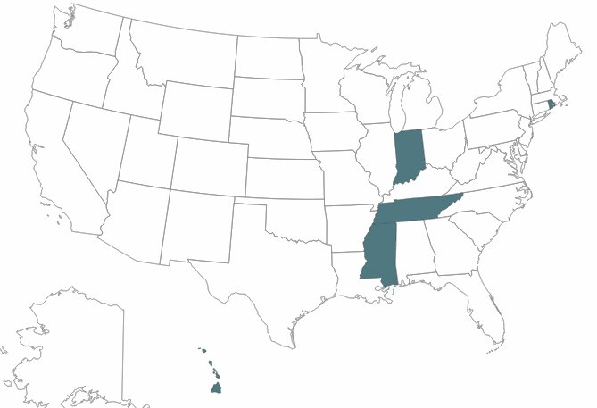
Shift and momentum building
Mississippi
Tennessee
Indiana
Hawaii
Rhode Island
Notes:
But a funny thing happened as we were doing this work. Other states began similar efforts.
Mississippi began an adult reengagement campaign statewide that they called Complete 2 Compete. Built upon similar work done in Indiana.
In 2017, legislation was passed in Tennessee to extend their promise program to adult learners by expanding an existing program called Tennessee Reconnect. Indiana passed legislation to do a promise program for adult learners who enroll in high tech certificate programs. Because of this legislation we were able to add Indiana to this project.
Finally, Hawaii also created a promise program without a lot of national fanfare. Adult students are eligible for this program
Lastly, Rhode Island is doing a lot of thinking and laying the groundwork to create an adult promise program.

Slide 15
But challenges remain
Exhausted aid eligibility may drive up cost to provide last dollar scholarship
State and institutional buy-in
State financial aid policies and eligibility requirements
Satisfactory Academic Progress cannot be reset
Outreach challenges
Cost to tailor services to adult students or expand hours to meet adult student schedules
Is the “some college, no degree” student really a low hanging fruit?
Notes:
So, it is apparent that the momentum building in many states has eliminated the disconnect we saw in 2016.
States made the connection that their looming attainment goals won’t be met without better serving adult students, and reengaging with adult learners.
That said, there are significant challenges to creating these programs.
Here’s what we believe they are.
Worst scenario is to get a student to return and see him or her fail again.

Slide 16
Design Template overview
Make the case to serve adult students
Estimate the cost of last dollar scholarship
Describe possible supports and services key to student success
Provide options for setting up pilot program parameters
http://www.sheeo.org/sites/default/files/Adult%20Promise%20Design%20Template.pdf

Slide 17
Continuum of support for adult student success
Outreach, Marketing, and Enrollment
Data challenges
Supports for Adult Student Success
Mentoring
Retention and Completion
Emergency aid funding
Targeting messaging
Debt forgiveness
On-campus childcare or childcare vouchers
Extended hours for support services
Alternative instructional delivery
Structured scheduling
Credit for prior learning
Focus groups
Degree maps
Continued mentoring

Slide 18
Supports and services that resonate with pilot states
Targeted outreach and messaging
More intensive coaching over mentoring
Micro loans/debt forgiveness
Emergency aid programs
Financial literacy programming
Benefits access
Connections to workforce and economic needs

Slide 19
Program parameters (i.e., how to pilot)
Student type
Income caps (e.g., up to $75,000)
Prior credit requirements (e.g., 50% of degree requirements)
Age limits
Stop outs
Degree type (two-year, four-year, certificates)
Pilot institutions or statewide

Slide 20
Maine
Pilot program at TBD selected institutions
Recently adopted an attainment goal
Last dollar scholarship
Institutional debt forgiveness and financial counseling
Wrap-around student support services. Aligning institutional and local efforts

Slide 21
Minnesota
Pilot program at four community colleges
Lake Superior College
Riverland Community College
South Central College
Inver Hills Community College
$2000 scholarship above other aid sources (not last dollar). Requires legislative action
Emergency aid program
Navigators/intensive coaching
Geared towards some college/no degree students

Slide 22
Oklahoma
Statewide effort
Degree programs tied to 100 Critical Occupations list
Expanding existing Reach Higher program for marketing and outreach
Last dollar scholarship from multiple sources
Strict student eligibility requirements (age, income, credit hours, GPA from prior work)

Slide 23
Washington
Statewide effort/Adult Reengagement Framework geared towards some college/no degree students
Emergency aid program to address financial holds on the front end during reenrollment
Web portal to guide students to an institution that fits their needs, connects them to an advisor at that institution
Strong need-based aid program can cover financial component

Slide 24
Indiana
Workforce Ready Grant created in 2017 legislation.
Last dollar scholarship for high-value certificates
Late addition to project. Statewide initiative
Institutional supports will be determined through CAEL assessment
Connections with local employers
Building upon You Can. Go Back. framework

Slide 25
Contact information
Andy Carlson
acarlson@sheeo.org
303-541-1607
@andymcarlson

