Slide 1
States Leading for Equity: Profiles of Action
Webinar featuring the actions of:
Minnesota Office of Higher Education and
Minnesota State Colleges and Universities
March 4, 2020

Slide 2
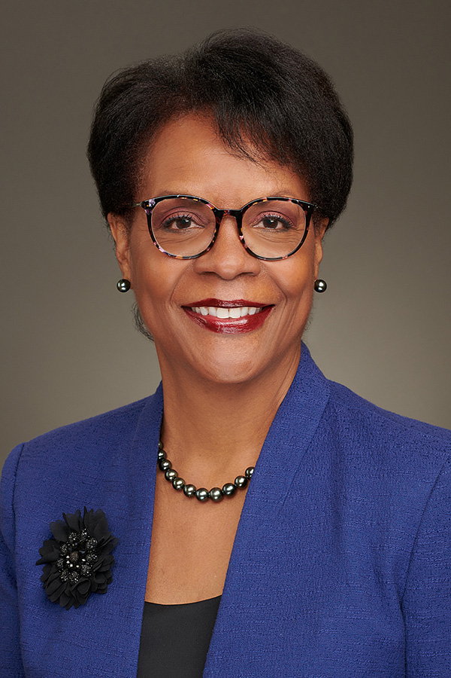
Welcome and Introductions
Welcome
Denise Pearson, VP Academic Affairs & Equity Initiatives
Overview of webinar series
Webinar format, logistics, Q&A
Speaker introductions
Dennis Olson, MN Office of Higher Education
Clyde Wilson Pickett, MN State Colleges & Universities
Josefina Landrieu, MN State Colleges & Universities

Slide 3
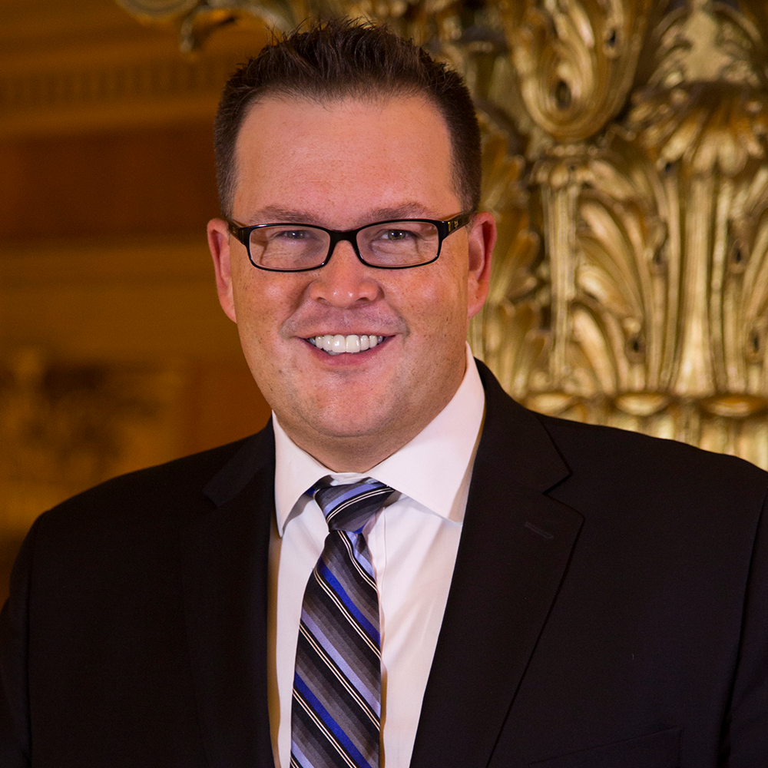
Dennis Olson Jr. – Minnesota Office of Higher Education
Dennis Olson Jr. was appointed by Governor Tim Walz as the commissioner of the Minnesota Office of Higher Education in January 2019. Prior to this executive cabinet appointment, he served as the executive director of the Minnesota Indian Affairs Council, working closely with tribal elected leaders, the state legislature, state agencies, and the governor to highlight and address issues important to all tribal nations and American Indian communities in Minnesota. Dennis also served as the director of the Office of Indian Education for the Minnesota Department of Education, working closely with tribal nations, urban American Indian communities, and multiple partner agencies to address issues impacting Indian education in Minnesota. Before joining state government, Dennis served as commissioner of education for the Mille Lacs Band of Ojibwe, and worked nearly 10 years in various capacities for the University of Minnesota, coordinating federally-funded grant programs focusing on postsecondary transition for American Indian high school students, students with disabilities, and at-risk youth.
Dennis, an enrolled member of the Fond du Lac Band of Lake Superior Chippewa, holds a Bachelor of Arts from the University of Minnesota Twin Cities in American Indian studies, sociology, and communications. He also holds master’s degrees in liberal studies (MLS) and education (M.Ed.) from the University of Minnesota Duluth, both with a focus on federal Indian policy and American Indian education.

Slide 4
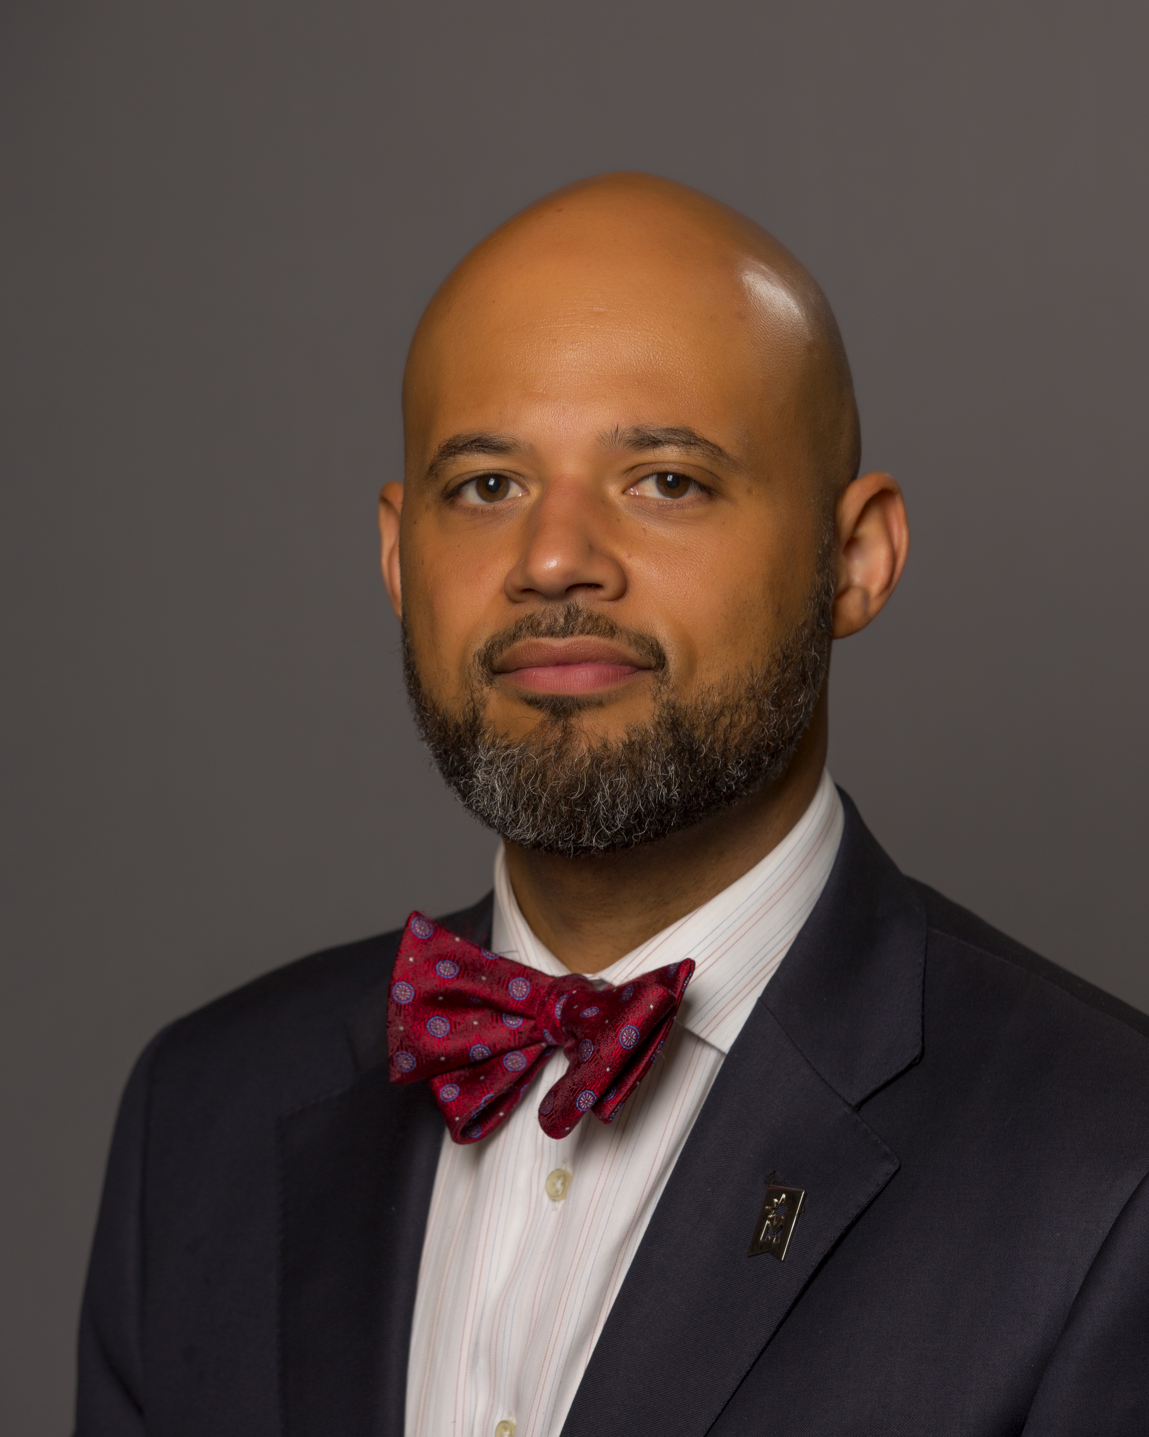
Minnesota State Colleges and Universities
Clyde Wilson Pickett currently serves as the system diversity officer for Minnesota State. Dr. Pickett was appointed to this position after a national search in October 2017. Prior to the appointment, he served as special assistant to the president for diversity and inclusion at the Community College of Allegheny County (CCAC) in Pittsburgh, PA. Dr. Pickett is recognized as a national leader in diversity in higher education and currently serves as second vice president of the board of directors for the National Association of Diversity Officers in Higher Education (NADOHE), the nation’s leading association of diversity professionals in the United States. He also serves as the chair of professional development for NADOHE and as a co-convener for the annual NADOHE Standards of Professional Practice Institute.
Dr. Pickett is the founder of two educational consulting firms that specialize in diversity training, strategic planning, program development, and management services. As a scholar, his work focuses on both institutional support for students of color in higher education and strategic development for equity initiatives in the academy. He is co-author of the book “Inclusive Directions: The Role of the Chief Diversity Officer in Community College Leadership.”

Slide 5
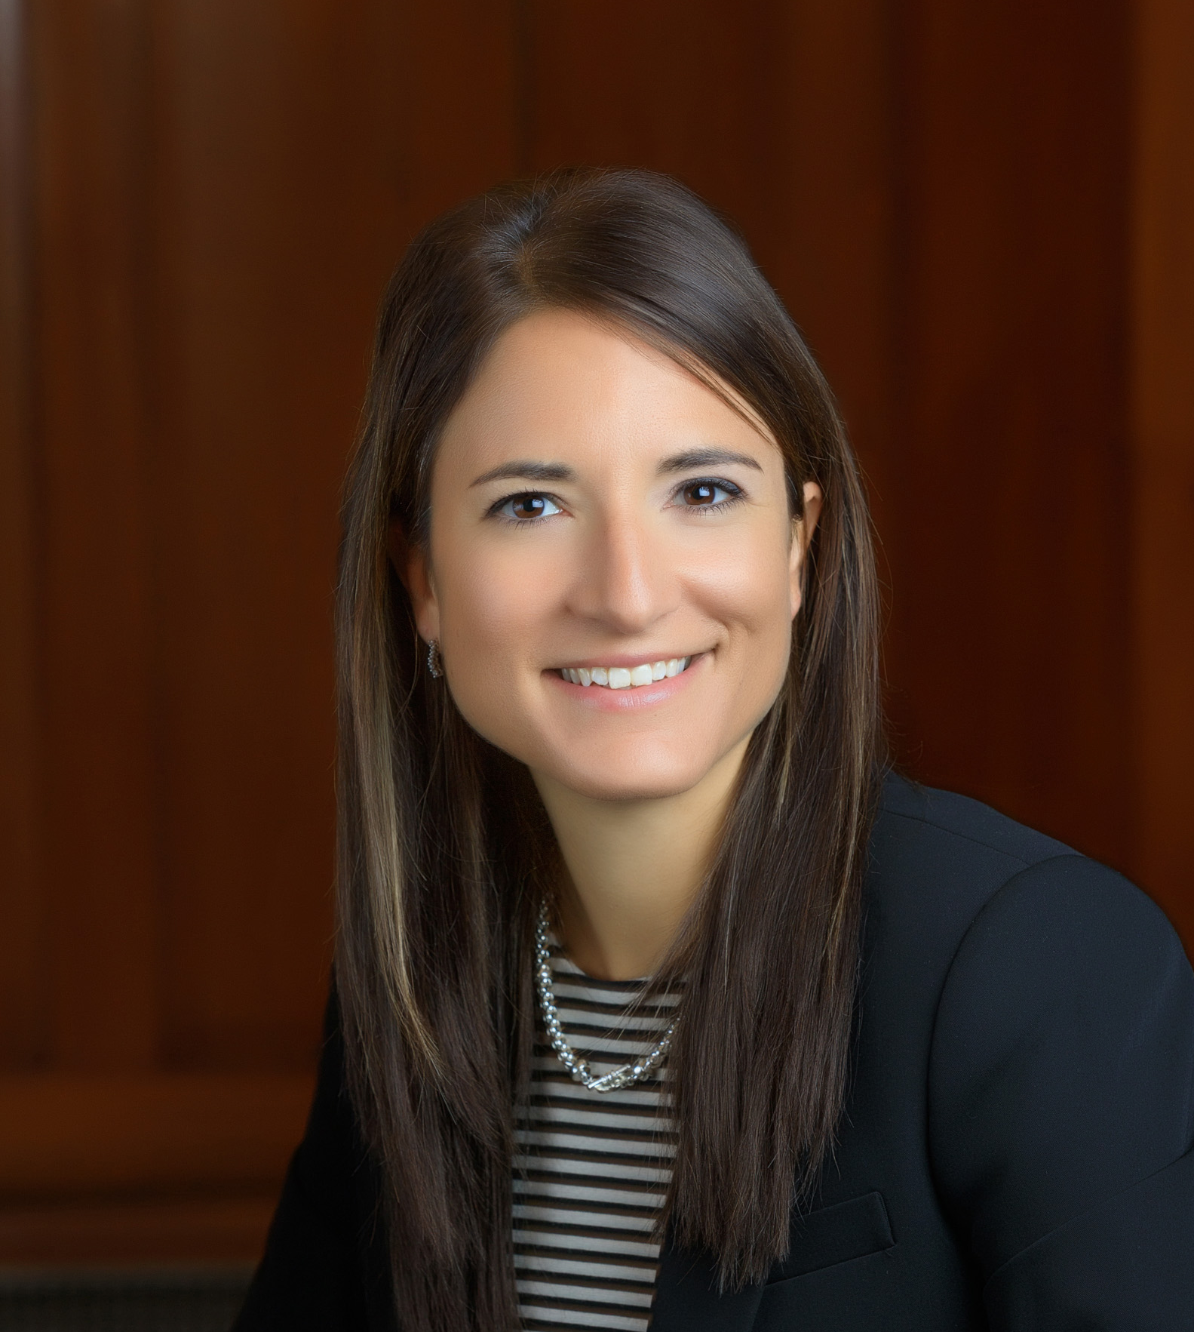
Minnesota State Colleges and Universities
Josefina Landrieu, Ph.D. joined the Minnesota State team in January 2015. From 2015 until 2017 she served as the Director for Equity Assessment, in early 2018 she transitioned to the Assistant Chief Diversity Officer role for the system. She provides leadership and support to advance the review of policies, procedures, and processes impacting inclusion and equity throughout the Minnesota State system as well as expertise and consultation for complex diversity and inclusion issues.
Before joining Minnesota State, Dr. Landrieu was in a state-wide role as Assistant Professor at the University of Minnesota Center for Youth Development. Her work and scholarship strive to ensure positive learning environments for students in higher education. As an innovative, creative problem solver and change leader Dr. Landrieu is focused on the changes needed in organizational structures, policies and culture in order to serve an ever changing student body.
Landrieu has a B.A. in Political Science and International Relations from the University of Norther Iowa, and an M.A. and Ph.D in Organizational Leadership and Policy Development from the University of Minnesota, Twin Cities.

Slide 6
OHE Program Overview
Dennis Olson, Jr.
Commissioner of Higher Education

Slide 7
Mission Statement
"To support the pursuit and completion of a higher education credential by every Minnesotan, regardless of race, gender, or socio-economic status, in order to enhance our democracy, the State's economic vitality, and individual quality of life."
Notes:
How do we do this?
MN State Grant
MN Reconnect
SELF Loan and SELF Refi
Childcare Grants
Summer Academic Enrichemt

Slide 8
OHE Programs and Services
Need-Based Aid
Minnesota State Grant Program
Average awards of over $2,000 awarded to 82,400 Minnesota students
Postsecondary Child Care Grants
Minnesota Indian Scholarship Program
Student and Parent Outreach
Early college awareness programs and initiatives
Get Ready – Gear Up Grant
Research
Produce independent, statewide information on postsecondary education
State Longitudinal Education Data System (SLEDS)

Slide 9
OHE Programs and Services
Minnesota College Savings Plan
Help families save for college with a 529 plan that offers tax-saving benefits
Licensing and Registration
Provides consumer protections for students and families
Register degree-granting private institutions
License occupational programs
Help resolve student complaints
SELF Loan
Long-term, low-interest student loan to help families cover the cost of college
SELF-Refi Program allows flexible refinance options for borrowers

Slide 10
Educational Attainment
In 2015, the Minnesota Legislature enacted a state postsecondary educational attainment goal that 70 percent of Minnesota adults (age 25 to 44) will have attained a postsecondary certificate or degree by 2025 (Minn. Laws 2015 Chapter 69 Article 3 Sec. 6).
The law also sets 30 and 50 percent educational attainment benchmarks for all races and ethnicities.

Slide 11
Certificates Versus Degrees
Certificates vs. Associate Degree or Higher Credential
13.4% of total credentials held are certificates
33.9% of total credentials held are certificates
20.4% of total credentials held are certificates
Notes:
Emphasize the differences in attainment between basic race groups.
Usually I bring up the Asian category and I hint at taking that category apart coming up

Slide 12
Catalyzing Change at the Local Level
Local Attainment Listening Sessions
Highlight local attainment data
Identify regional needs
Invite local chambers of commerce, tribal nations, community organizations, k-12 & higher education leadership, staff, students, and parents
Funding support from the Rockefeller Foundation
Goals:
Spread the word about educational attainment, disparities & build the case for going to college
Listen – what are the barriers to college going and college completion? What are their fears? What are they angry about? What are their hopes?
Move to Phase 2 Engagement - Identify and recruit local educational attainment champions to build on the conversation and identify actions to take

Slide 13
New Governor = New Play Book
Minnesota Governor Tim Walz and Lieutenant Governor Peggy Flanagan took office on January 7, 2019
New focus on equity throughout state enterprise and agency strategic planning, throughout the legislative process, and in community and public engagement.
Enterprise and Agency Strategic Planning:
Need for greater data disaggregation
Intentional focus on race, ethnicity, gender, geography, and disability status
Creating a roadmap aligning actions across agencies to meet state level goals/targets
Public Engagement:
Created Deputy Chief of Staff for Public Engagement
Legislative Proposals must include engagement plan and be equity focused
Governor’s Chief Inclusion Officer – State enterprise recruitment and retention goals
Strengthen work with Tribal Nations
Executive Order 19-24 - Meaningful tribal consultation on all budget and policy issues
All appointees, senior staff, and managers will attend Tribal-State Relations Training

Slide 14
Intentional Engagement Across Organizations
Minnesota Office of Higher Education initiatives:
MN DREAM Act and supplemental Pell grant proposal
Teachers of Color and American Indian Teachers
Loan forgiveness programs
Teacher candidate grants
Cross-agency work supporting student success (system change)
Governor’s Children’s Cabinet – focus on families
Housing – Interagency Council to Prevent and End Homelessness
Corrections – Higher Education for incarcerated individuals and justice involved
Interagency Workforce Goal – Focus on Family-sustaining income
DEED/MinnState – Credential Engine, credentials of value
MinnState – Quality Assurance, All Learning Counts, Degrees When Due, MN Reconnect
DHS/OHE – SNAP E&T expansion for college students
P20 Partnership – Focus on equity in educational attainment

Slide 15
Systems Work: We can do better
Minnesota has a strong financial aid and program foundation, but we haven’t focused on POCI and historically underserved communities.
“Minnesota Nice” – We’re really good at talking about it…
We’re constantly asking ourselves these questions:
How do you ensure equity when financial aid is race blind?
Do our administrative processes create burdens for specific student groups?
Are our applications and materials culturally competent?
Are we actually reaching the communities we need to reach?
How do ensure students are informing our work and how we do our work?

Slide 16
Minnesota State Colleges and Universities
Dr. Clyde Wilson Pickett
Dr. Josefina Landrieu

Slide 17
Minnesota State
350,000 Students annually
245,000 in credit classes
100,000+ in non-credit programs
59% in greater Minnesota
120,000 from underrepresented groups
43,900 first generation students
9,200 veterans
37 Colleges and Universities
54 campuses
30 state colleges
7 state universities
47 Communities across the state
From International Falls to Worthington
Enrollment ranges from 482 to 17,881 FYE

Slide 18
Minnesota State
38,000+
degrees, certificates, and diplomas awarded each year
Our colleges and universities serve students no matter where they are on their educational journey – from a certificate all the way to an applied doctoral program.
Many of our students also come to us to take non-credit courses, such as customized training, specialized courses or professional classes.
15,000+
customized training, occupational, and professional classes offered
3,900+
academic programs to choose from
710
programs offered entirely online

Slide 19
Minnesota State
We educate …
9 out of 10 mechanics
9 out of 10 in manufacturing
8 out of 10 in law enforcement
2 out of 3 nurses
7 out of 10 in trades
6 out of 10 in agriculture
50% of all teachers
50% of IT professionals
50% of all business graduates

Slide 20
MINNESOTA STATE: EQUITY 2030
Goal:
By 2030, Minnesota State will eliminate the educational equity gaps at every Minnesota State college and university.
Notes:
Strategic Questions
How can Minnesota State capitalize on both traditional strengths and new opportunities to fortify its teaching and research globally?
As we reimagine Minnesota State, are there other opportunities that the Board sees for expanding this work and increasing alignment with statewide workforce development efforts?
Are there additional policy implications that we should consider as we further this work?

Slide 21
MINNESOTA STATE – EQUITY 2030
Minnesota State will eliminate the educational equity gaps at every Minnesota State college and university.
Increase student retention, persistence, and graduation
Increase the percent of Minnesotans age 25 to 44 who have attained a postsecondary certificate or degree to 70 percent across all populations (Minnesota’s Educational Attainment Goal 2025)
Increase market share of high school graduates and the transfer rate from our two-year colleges to our universities
Increase the number of post-traditional (adult) learners

Slide 22
Understanding our data is the first critical step
We need to understand our data using three lenses
By race and ethnicity
First generation status
Socioeconomic status
Increase student retention, persistence, and graduation
Increase the percent of Minnesotans age 25 to 44 who have attained a postsecondary certificate or degree to 70 percent across all populations (State of Minnesota’s Educational Attainment Goal 2025*)
Increase market share of high school graduates and the transfer rate from our two-year colleges to our universities
Increase the number of post-traditional (adult) learners
To track our student success and impact
In order to meet the Equity 2030 goal
Minnesota State will eliminate the educational equity gaps at every Minnesota State college and university
* The 2015 Minnesota Legislature enacted legislation setting a target that 70 percent of Minnesota adults age 25 to 44 will have attained a postsecondary certificate or degree by 2025.
Notes:
Our summer work has focused on understanding our data better. To just say we are going to eliminate the educational equity gaps, we need to understand where they exist and how to begin to tackle them.
We need to establish clear benchmarks and targets to measure and monitor progress. Now, there are a multitude of different lenses by which we could look at our work but we have decided to focus on three primary areas to disaggregate the data:
By race and ethnicity
First generation status
Socioeconomic status

Slide 23
We identified a capacity gap and a need to draw in additional system expertise to make progress on establishing and refining the Equity 2030 goals
Chancellor’s Fellows
Target Setting | Predictive Modeling | Academic Equity Strategy
Lead the development of a comprehensive and holistic approach for effective target setting for the system to provide more effective monitoring of the achievement of goals and minimize overlapping targets and the confusion resulting from similar, but not identical, targets set as part of multiple initiatives. | Lead the development of predictive models for understanding and driving equitable, quality outcomes for all students and develop a final product with an eye to building replicable frameworks that can be used or modified at the campus level. | Lead the development of system-wide strategies to confront long-standing issues including discrimination based on race, ethnicity, language, gender, sexual orientation, disability and poverty. Prioritizing the use of an equity lens, the Fellow will assist with research and strategy in building replicable frameworks for use and the system and on campuses to advance equity in academic outcomes.
Notes:
As you have heard me say throughout the way that if we could have eliminated the gaps on our own, we would have. But that in order to really do this work effectively, we must engage with community partners and other state agencies to identify resources and opportunities to address the non-academic barriers that our students face.
I have already had conversations with Lt. Governor Flanagan, Office of Higher Education Commissioner Dennis Olson and others from their teams about this work and I think I can say that they will be enthusiastic partners as we go forward.
Later this fall, I will kick-off a series of learning sessions with community leaders. Learning from those conversations will result in the development of the Equity Summit.
We will ask partners to review their respective work through an educational lens: Be intentional, study the barriers and then bring their “work results” to this Equity Summit.
We will leverage our systemness and seek feedback, do research and then update the data accordingly.

Slide 24
INTENTIONAL INCLUSION FRAMEWORK OVERVIEW
Transformative Inclusion or Intentional Inclusion framework is a commitment to fostering a campus environment that not only recognizes perspectives, skills, experiences and talents, of every student, staff, faculty member, and administrator, but rather cultivates and utilizes those “abilities” to achieve more a robust, invested, and creative campus environment.
Intentional Inclusion is commitment, mindset, and continuous process interwoven in the fabric of the college.
Notes:
Organizational Attributes
Diversity, equity, and inclusion initiatives and strategy are proactive and ALWAYS imperative.
**Key IDEA*
Inclusion support is important not just when there is a discrimination complaint or major issue.
The organization’s culture is based on inclusion and not just on representation.
Organization advances and operationalizes cultural competency.
There is visible diversity at all levels of the organization.
Strategic Planning is an essential component to advance any model or institutional effort to advance diversity, equity, and inclusion. The execution of the plan must involve the engagement of critical stakeholders in the process and provide regular review and monitoring for successful implementation.
The planning team should be make sure that staff and faculty are given the freedom to proceed with day-to-day implementation once any plan is complete.
Senior Leaders should regularly monitor progress so that additional support on a task-by-task basis can be provided if progress slows.

Slide 25
TRANSFORMATIVE INCLUSION FRAMEWORK
Transformative Inclusion Framework
Equity Based Lens to Policy Review
Supportive Campus Climate
Equity Based Lens to Policy Review
Prioritization of an inclusive an inclusive review of system/institutional policies with a commitment to amend and take action
Priority on Student Success
Supportive Campus Climate
Evidenced based understanding of experiences to address and create more inclusive environments for all stakeholders
Priority on Student Success
Purposeful development and use of organizational resources to enhance student learning and positive academic outcomes

Slide 26
Applying an Equity Lens to Policy Review

Slide 27
WHAT IS AN EQUITY LENS?
A process for analyzing or diagnosing the impact of the design and implementation of policies on under-served and marginalized individuals and groups.
A way to identify and eliminate barriers.
It is deliberately conscious of disparities.
It prioritizes institutional accountability.

Slide 28
EFFECTIVE USE OF A TOOL
Assess policy intent and inclusiveness
Uncover policy assumptions
Make equity a priority
Invite reflection and discussion on the ways in which our policies can advance equity.

Slide 29
Minnesota State Campus Climate Assessment
Advancing Employee Engagement
& Student Success
Notes:
CCA: Campus Climate Assessment ACE: Assessment of Climate & Engagement CEA: Climate & Engagement Assessment
Higher levels of engagement with diversity
(via cross-racial interaction, ethnic studies courses, education, service, etc.) are linked to:
Greater cognitive development
More positive academic and social self-concept
Higher graduation rates
Reduced prejudice
Growth in leadership skills and cultural awareness/understanding
Higher levels of civic interest
More complex thinking
Greater college satisfaction
Increased employee retention
Increased staff productivity

Slide 30
purpose
To address students' equity and educational outcomes by identifying the elements of a diverse learning and work environment among Minnesota State institutions. A climate assessment of students and staff perspectives and experiences among colleges and universities can provide data on climate elements that not only impact the educational outcomes of students but also bring to light gaps and needs to be addressed.
Key Areas of Interest
Employee Engagement & Development
Student Success & Engagement
Campus Climate
Equity & Inclusion
Notes:
Josefina
The purpose of this work is to address student’s equity and educational outcomes. Last month presentations to the board highlighted the opportunity and success gaps among Minnesota State students. Campus climate assessment provides us with an opportunity to take a deeper look at the learning environment from the perspective of those experiencing such environments.
The assessment of campus climate will better position our institutions to effectively serve their students and also address gaps and needs to reduce educational disparities.

Slide 31
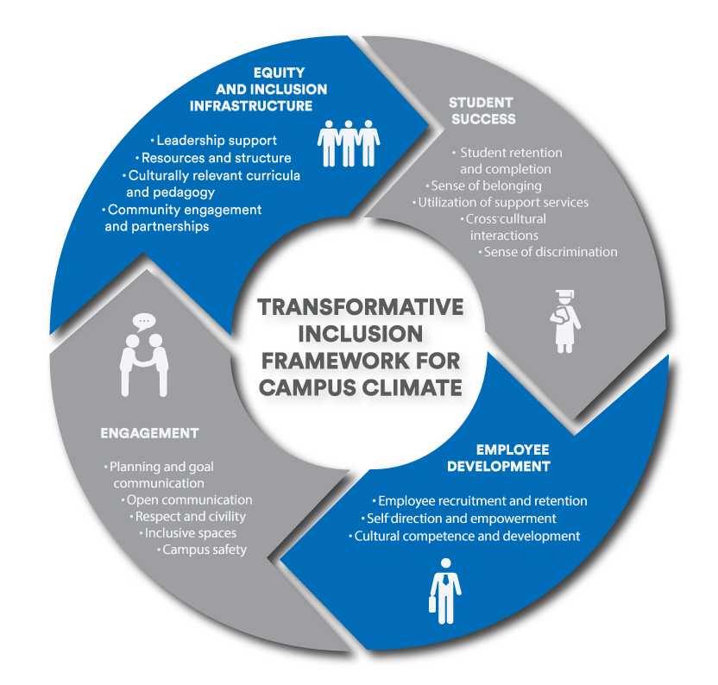
TRANSFORMATIVE INCLUSION FRAMEWORK
Landrieu & Pickett, A Campus Climate Framework for Transformative Inclusion (2018)
Notes:
Clyde

Slide 32
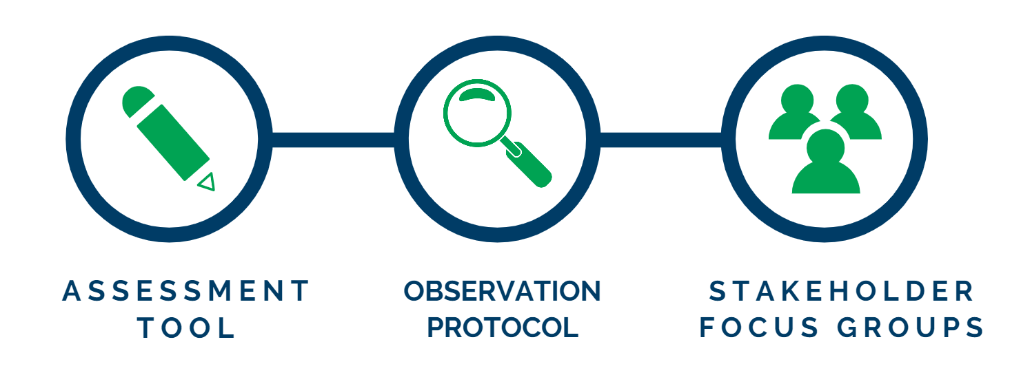
METHODOLOGY: CCA CONSISTS OF 3 COMPONENTS
Assessment Tool
60 Employee Questions, 34 Student Questions
12 Demographic/Characteristic Questions
Observational Protocol
Stakeholder Focus Groups
Notes:
A couple of results
Shared preliminary reports initial results with institutions

Slide 33
CCA KEY AREAS OF INTEREST
Trust & Respect
Campus Climate
Communication
Prioritization
Student Success Importance
Resources
Development & Training
Employee Engagement
Sense of Support
Peoples Experiences
Equity & Inclusion
Communication & Feedback
Policy & Strategy
Employee Supervisor Relationships
Supportive of Equity & Inclusion
Notes:
What do you think is needed to drive change at your institution?
Conversation to help identify what needs to be done at the campus level.
Feeling valued?
Belonging?

Slide 34
Minnesota State Guided Learning Pathways Framework
Notes:
Following last year’s Reimagining Minnesota State initiative, there were markers that came out and crystalized for me:
Need to make our campuses more flexible and innovative
The higher education of tomorrow will focus on personalized and customized educational paths
The higher education system of tomorrow will be characterized by experiential learning where learning no matter where developed will be validated
Heighted focus on educational equity gaps
Integrated learning across disciplines and across institutions
Against this backdrop Equity 2030 is the value proposition of a public higher education system in MN
We do this work not only because it is a moral imperative but also an economic imperative
I promised the Board in June that I would bring forward a refined vision for the board and that is what I am bringing forward today. The proposed approach is open to modifications and adjustments and I am looking forward to the feedback by the board and others in the coming months.
But first, I want to thank Sr. Vice Chancellor Anderson, System Diversity Officer Pickett, Interim Vice Chancellor Maki, Interim Sr. System Director Sue Carter, and Chief of Staff Simonsen for meeting each week this past summer as we began to sort out and assemble the framework and approach that I will share today.

Slide 35
Minnesota State Guided Learning Pathways Framework
Three focal areas:
Curricular/program design and delivery
Comprehensive Orientation and First-Year Experience
Holistic Advising and Comprehensive Student Support

Slide 36
Minnesota State Guided Learning Pathways Framework
Curricular/program design and delivery
Curricula reflects diverse perspectives across the field
Curricula and instruction are culturally relevant and responsive
Program pathway is coherent and aligned with statewide transfer pathways
Required core curriculum and general education courses are clearly articulated
Recommended elective courses are clearly articulated
Programs are mapped to careers or further education
Discipline-appropriate curricular strategies for active, collaborative, applied, and experiential learning experiences are designed throughout the pathway
Discipline-appropriate co-curricular learning opportunities are designed throughout the pathway
Assessment processes are clearly articulated, executed, and used to improve instruction and student learning
Default course sequences are clearly articulated, and courses are consistently scheduled and offered in alignment with those sequences and student needs
Curricular design and course scheduling encourage academic momentum and appropriate credit intensity
Milestone courses are clearly articulated and used to track student progression through the program

Slide 37
Minnesota State Guided Learning Pathways Framework
Comprehensive Orientation and First-Year Experience
Transactional information is provided online in a guided format and offered to students for completion prior to arrival on campus
Comprehensive on-campus and/or online orientation is provided, including interactive sessions on how to navigate systems and processes, including financial aid, emergency financial resources, academic support, student engagement opportunities, and basic needs resources available to students
Additional enhancements may also include:
Social belonging intervention
Bystander intervention programming
Career assessment and exploration is provided, and aligned with program pathways

Slide 38
Minnesota State Guided Learning Pathways Framework
Holistic Advising and Comprehensive Student Support
Advising and student support services are culturally relevant and responsive
Holistic advising is integrated into first-year student learning communities, FYE courses, and/or student success courses
Advising is provided by designated faculty/staff with sustained proactive outreach and involvement
Recognition of milestone achievements
Early alert process to facilitate interventions for students who show signs of academic or social trouble
Required advising when students veer off a selected pathway
Comprehensive student support is available to all students, including assistance with basic needs in areas including: mental health; food; housing; transportation; child care; and emergency financial assistance

Slide 39
Minnesota State Guided Learning Pathways Framework
Approach
Defined core characteristics of effective practice
Campus review and assessment of alignment between current practices with the core characteristics
Campus prioritization of practice changes needed to bring the model framework to scale

Slide 40
Minnesota State EQUITY by Design

Slide 41
EQUITY BY DESIGN CONCEPTUAL OVERVIEW
Equity by Design is a methodology that equips higher education leaders to address educational disparities and to move beyond policy and planning to institutional equity-minded practices.
Data-informed
Influences organizational development
Influences change management strategy
Prepares institutions to be student-ready
Prioritizes equity in academic outcomes
Student-ready institutions
Leadership philosophy
Localized context
Institutional change
Accountability
The methodology is influenced by the scholarly research and literature of Dr. Estela Bensimon (2014) at the Center for Urban Education at the University of Southern California.

Slide 42
INTENTIONALITY BY DESIGN
Clarity in GOALS and LANGUAGE
A vision and a practice
Intersections of diversity, inclusion AND equity
Excellence in learning, teaching, student development, institutional operations, and engagement with communities.

Slide 43
LEADERSHIP PHILOSOPHY
Institutional level commitment
Commitment to understanding equity.
The ability to lead a campus team through the methodology in an intentional and equity-focused way.
Support data disaggregation and analysis close to practice.
Lead and support faculty and academic leaders to take an in-depth view of course success rates.
Notes:
Higher education leaders who wish to engage their campus teams in this methodology are committed to understanding equity, they have the ability to lead in intentional equity-minded ways. More importantly, these leaders support data disaggregation and analysis close to practice; in doing so they support faculty and academic leaders to take an in-depth view of department and course success rates.

Slide 44
LOCALIZED CONTEXT
The Equity by Design methodology considers the institutional readiness to implement the work on campus.
Level of maturation (equity & inclusion)
Campus and community context (socio-historical)
Capacity (data, research, and equity infrastructure)

Slide 45
INSTITUTIONAL CHANGE
Equity by Design requires higher education to make changes at the institutional level as campuses strive to be student-ready spaces.
As a result of engaging in an Equity by Design process:
Campuses apply a magnifying glass to data and practices that illustrate academic equity-gaps.
Campus teams and leaders will drive change in organizational structures, practices, and policies.
Notes:
24 overlapping questions for employees & students
MCTC – did not employees
SMSU, NHCC, Metro State U, Minneapolis-CTC

Slide 46
ACCOUNTABILITY
Equity by Design tools and resources necessitate data-informed analysis of equity gaps at the department or course level.
Campus teams seek to understand disparate impact of policies and practices and move to address such disparities.
Ensure that campus leaders take responsibility to determine campus-based solutions that address academic equity gaps.
Data-informed decisions (Equity Scorecard)
Notes:
24 overlapping questions for employees & students
MCTC – did not employees
SMSU, NHCC, Metro State U, Minneapolis-CTC

Slide 47
WHAT DOES IT LOOK LIKE ON CAMPUS?
History Map in Context (Campus)
Developing Equity-Minded Language
Data Analysis with an Equity Lens
Equity Gap Calculator
Equity-Minded Recommendations
Observation Protocol
Campus Strategy Implementation

Slide 48
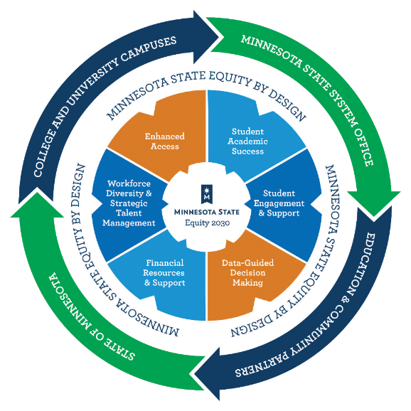
SYSTEM AND CAMPUS APPROACHES
SYSTEM (Macro-level)
Methodology implementation
Workbook development
Technical assistance
Potential for broader impact
System-wide metrics and accountability (Equity Scorecard)
CAMPUS (Micro-level)
Apply Equity by Design methodology
Intrusive academic support with case management
Capacity building
Partnership and communication with faculty
- Practices
- Culture
- Policy
- Structures
Equity by
Design
Implementation
Interventions

Slide 49
Questions & Answers

Slide 50
Thank you!
Dennis Olson
Dennis.w.olson@state.mn.us
Clyde Wilson Pickett
Clyde.Pickett@minnstate.edu
Josefina Landrieu
josefina.landrieu@minnstate.edu
Denise Pearson
dpearson@sheeo.org

